Slide 1

Measuring the Federal (Public) Funding of Research & Development Projects Using Administrative Data
26 July 2019

Slide 2
The NCSES UVA Team
NCSES
John Jankowski, PhD
UVA
Stephanie Shipp, PhD
Sam Cohen, PhD
Joel Thurston, PhD
Alyssa Fowers
Sean Pietrowicz

Slide 3
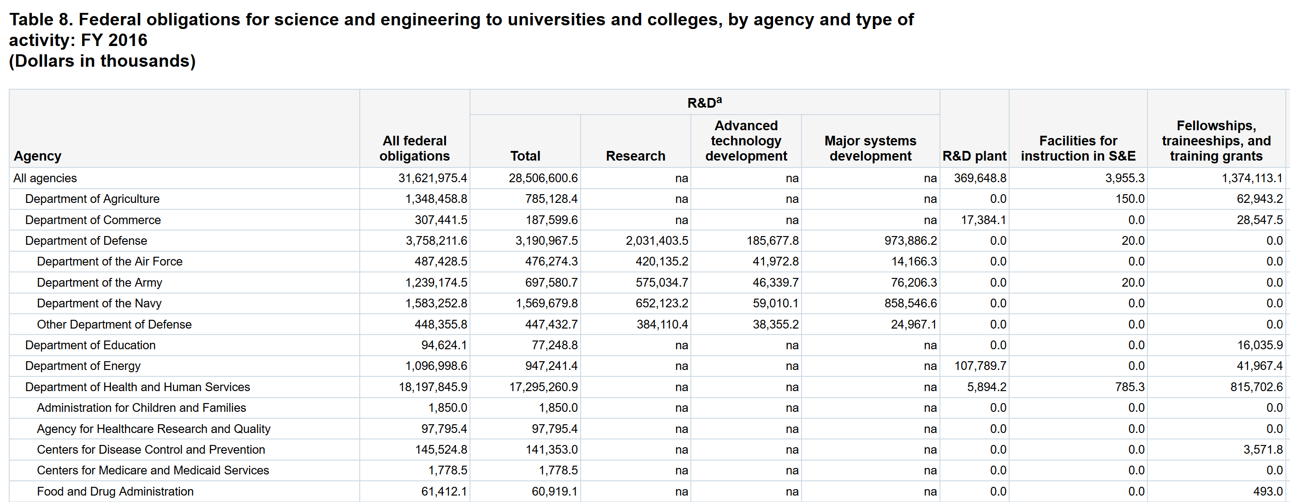
Why build an R&D microlevel database?

Slide 4
Several requirements were essential to accurately benchmarking to FFS.
Intended use of funds (R&D)
Project-level data
Recipient of funds
Dates based on transaction

Slide 5














SDAD’s Data Science Framework reliably and exhaustively profiles data sources.

Slide 6


Data Discovery: Coverage
Each agency has some amount of coverage in our data sources, but we are still evaluating the completeness of that coverage.
Energy
Defense
Source
Fed RePORTER
USA Spending
Current Research Information System
Conservation Innovation Grants project list
NIH Project Exporter
Conservation Innovation Grants All Project List
NSF Award Search
Office of Science Awards
DOE Public Access Gateway for Energy & Science (PAGES)
ARPA-E Projects
Total Potential Data Sources | 4 | 2 | 2 | 3 | 3 | 5

Slide 7
FedReporter is an excellent source of R&D, but lacking in documentation.
Pro:
Completely R&D
Project-level data
Con:
All types of recipients
Date is based on award fiscal year

Slide 8
USA Spending is more comprehensive than Fedreporter.
Pro:
Project-level data
Limited to universities/non-profits
Organized by individual payments
Con:
Funding beyond R&D and S&E
Contracts and grants treated differently
Notes:
LIMITS ANALYSIS TO EXCLUDE BUSINESSES!!!!

Slide 9
Takeaway 1: These sources must be extensively profiled before use.
DUNS numbers, titles, and project IDs vary between payments of same project.
Date formatting can dramatically alter estimates
Fields vary for different types of awards
To date, limited opportunities for identifying subtypes.

Slide 10
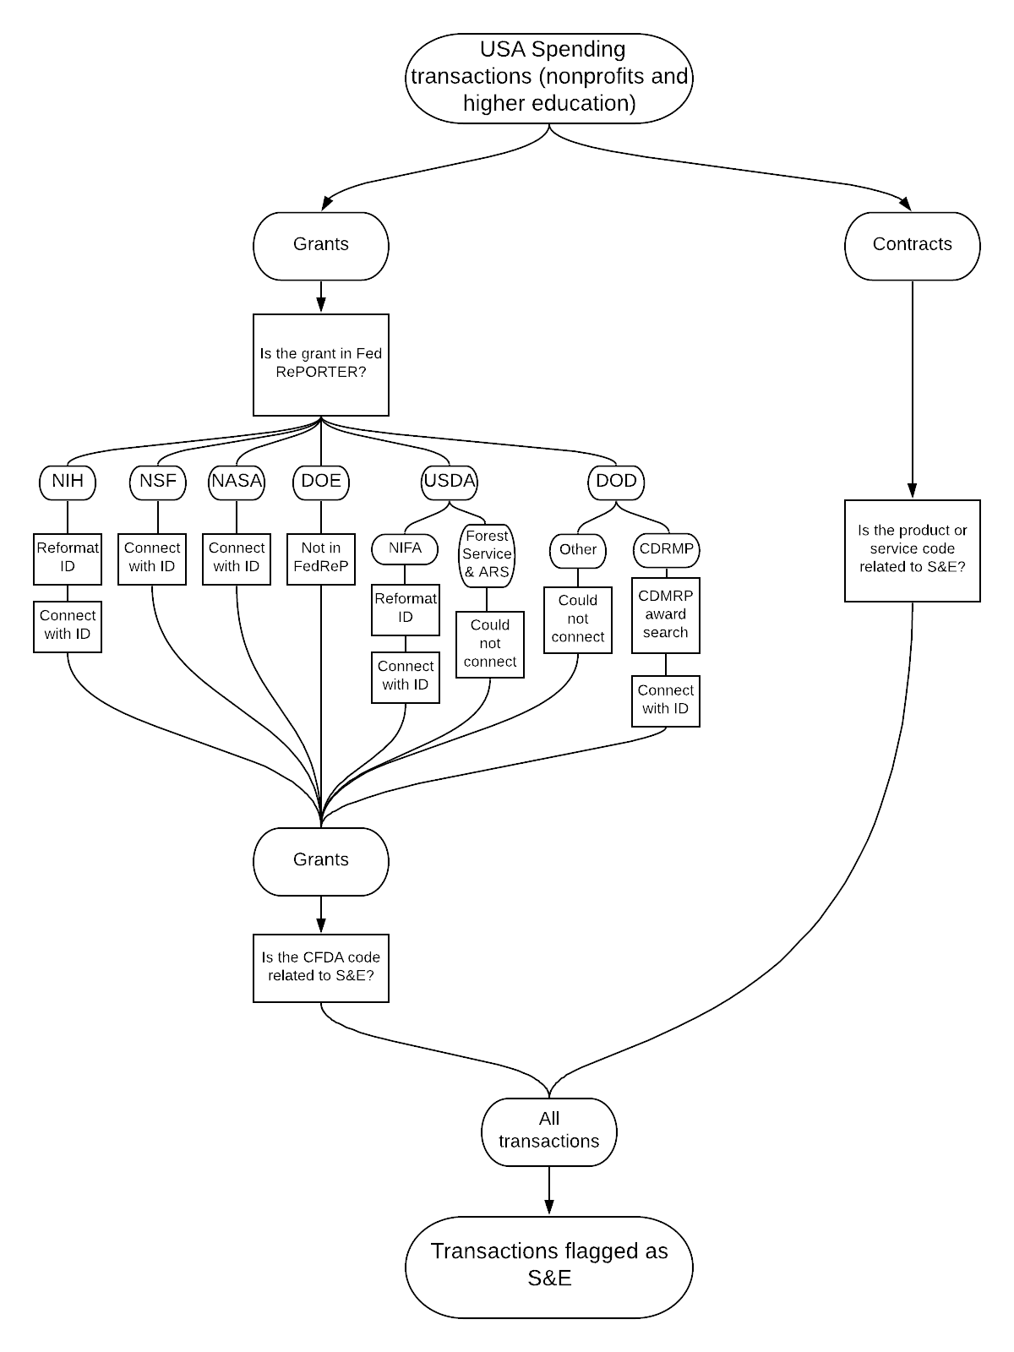

Slide 11
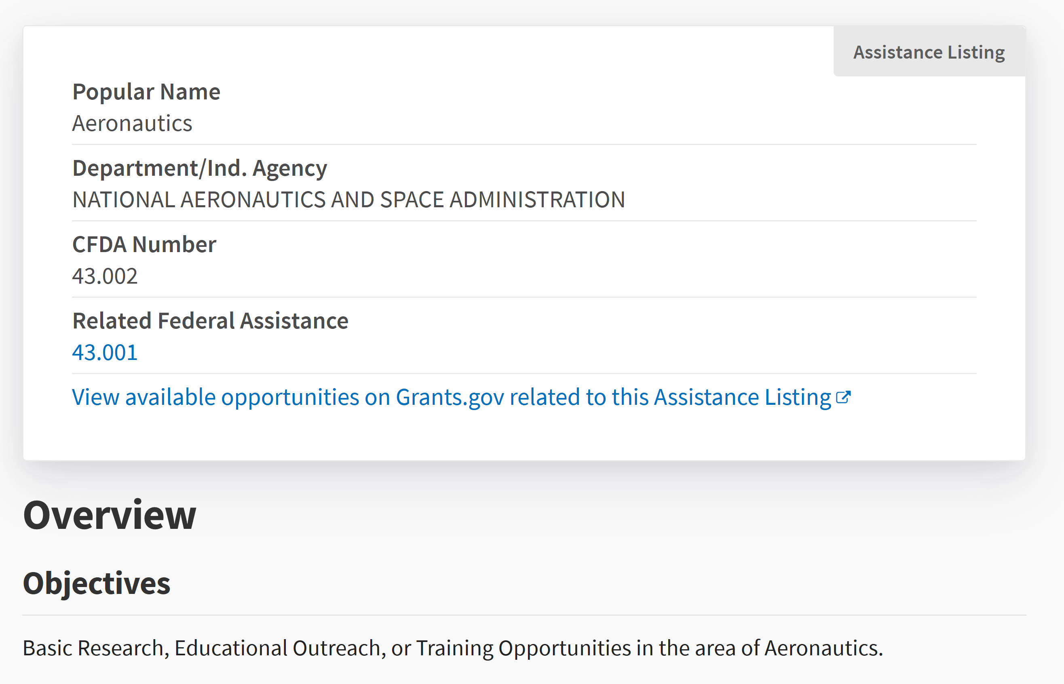
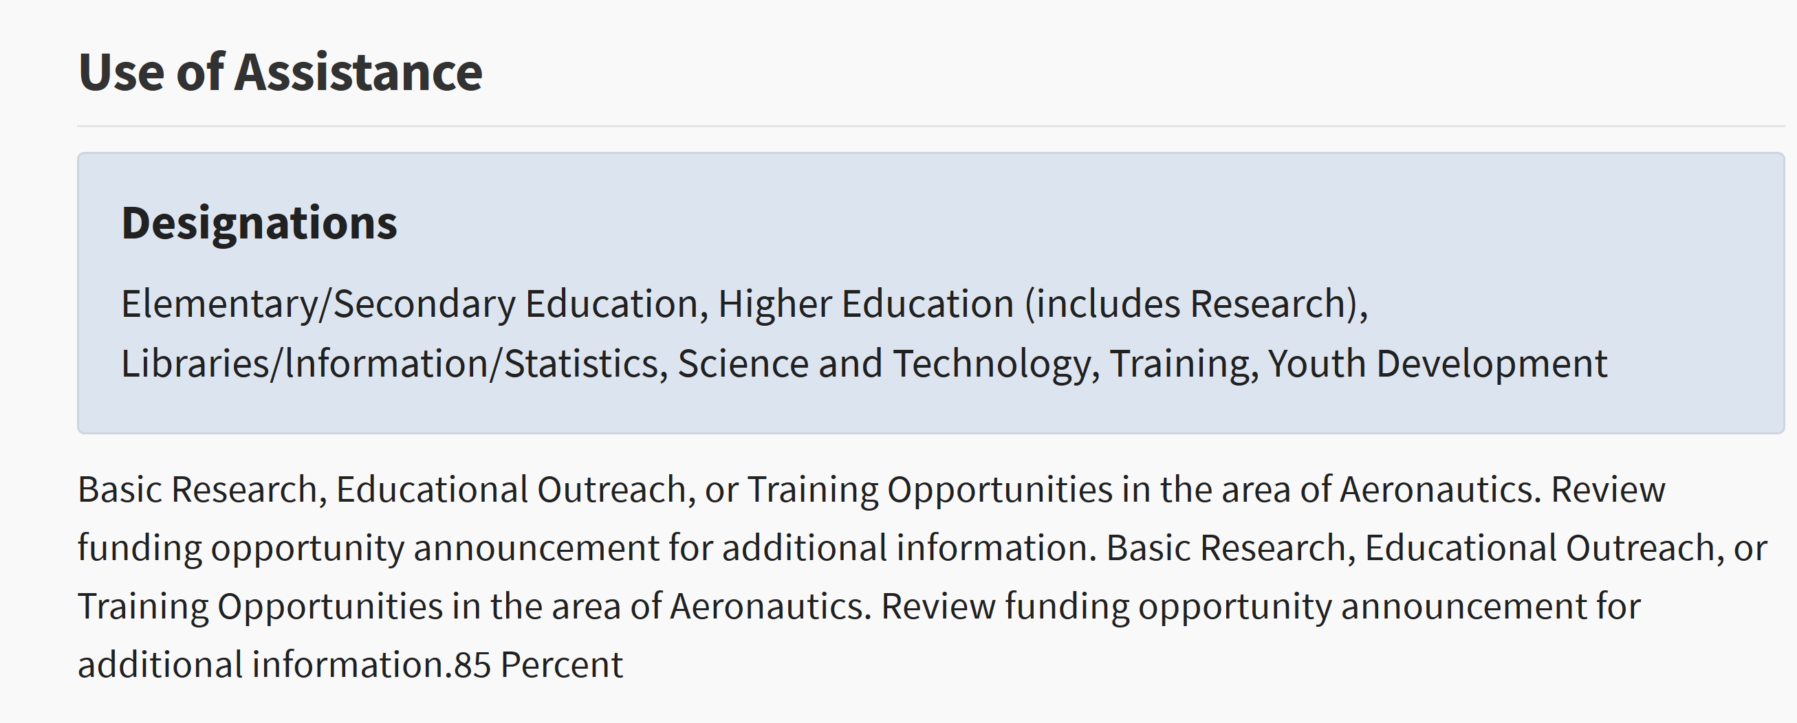
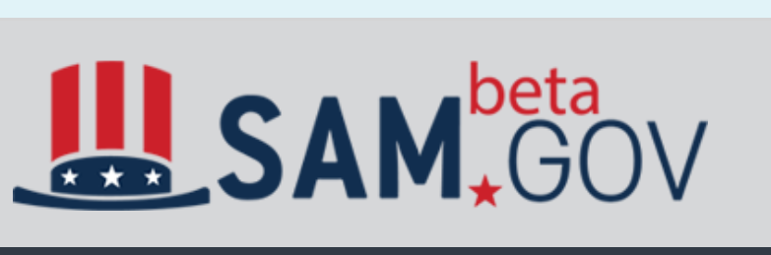
A CFDA code is sufficient for determining S&E, but not its subcomponents.

Slide 13
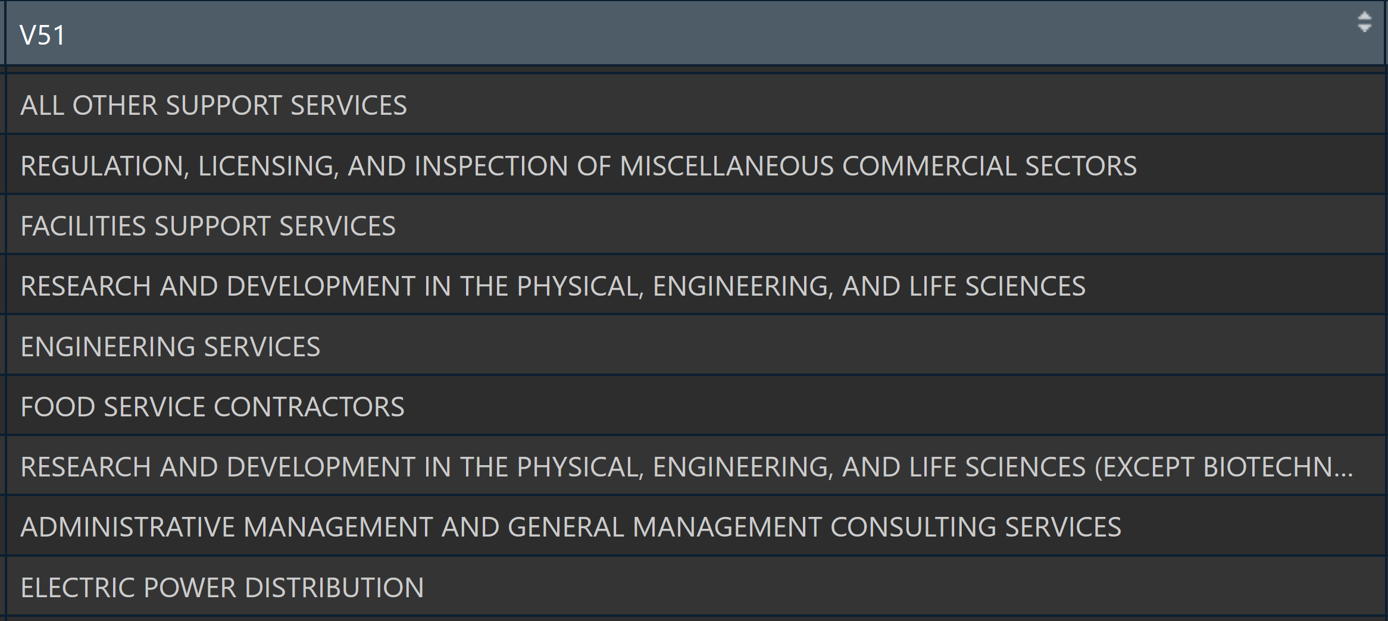
Product Codes Provide Limited Information About Intended Purposes.

Slide 15
We compared our conservative estimates to the FFS 2016 survey.
Notes:
Analysis limited to funding to overall S&E activity in colleges/universities in 2016.

Slide 16
Takeaway 2: With our current approach, estimates of S&E seem underreported.

Slide 17
Takeway 3: This approach is feasible, but limited in scope.
Only universities and non-profits
Additional validation of FedReporter required
Still difficult to ascertain specifics of project.
CFDA codes prevent finer-grained analysis
Current approach is conservative.
Thousands of codes.

Slide 18
Thank You!

Slide 19
Supplementary Slides

Slide 20
Data Discovery: Screening
Ease of obtaining/ interpreting data
Matching to survey data
Enabling detailed analysis
Basic information
Start more detailed profiling with Federal RePORTER and USAspending.gov
Data dictionaries
Basic vs applied research
Linked to publications
Grants vs cooperative agreements
R&D vs general S&E
Institution type
Notes:
Asked 27 screening questions of 11 publicly available databases.
Good date coverage, some direct downloads available, detailed information about areas of inquiry and research institutions.

Slide 21
Focus on Fed RePORTER and USA Spending
 | Fed RePORTER | USA Spending (Transaction)
Level of detail | Project | Transaction
Dates | Notification of grant award | Transaction date
Detailed information on projects? | Project title and keywords | “Award description” and CFDA title
Easy to determine what is research? | Yes | No
Easy to determine institution type? | No | Yes: can choose to download only grants to nonprofit/higher ed

Slide 22
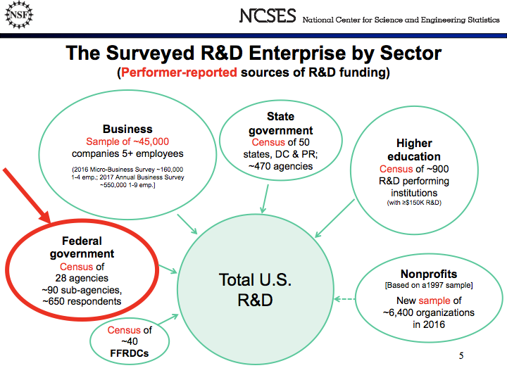
Notes:
The NSF collects data from all sectors about their sources of R&D funding. They collect this data using surveys and censuses. We are interested in assessing the feasibility of measuring federal public funding of R&D to universities and nonprofit organizations using administrative data in place of a survey of federal agencies. (In this case, it is actually a census because all agencies are included.)

Slide 23
Data Profiling
Assessing data quality:
Completeness: % of values that are not blank or NA
Value validity: % of values in the right format for information (e.g. dates in a date field, only actual state names in state fields, etc.)
What percentage of projects and funding is accounted for?
%, count, and total dollar amount of grants in each department, sub-agency and office - compare against the NSF Survey of Federal Science … Support (FSS)

Slide 24
Completeness
Frequency of Congressional District Entries
CONGRESSIONAL_DISTRICT | freq
07 | 12010
02 | 8733
01 | 7612
05 | 7228
N/A | 6560
03 | 6294
12 | 6125
04 | 4090
13 | 3874
09 | 3019
How much data are missing?
Created an automated process that returns percentages of complete (not N/A or blank) values for each field in the dataset
Especially relevant for tracking funding amounts and organization name

Slide 25
Validity
How much data are relevant and correctly formatted?
Specialized process for each field that tracks amount of incorrectly formatted and misplaced data.
Process returns the percentage of projects and funding inputted correctly
Prepared R scripts to:
Ensure proper formatting for
state abbreviations, zip codes and city names
DUNS numbers, CFDA codes and project IDs
author names, dates and funding totals
Examine each department, agency, state and country name to check valid classifications

Slide 26

What's Included in Fed Reporter and USA Spending?
Title: Novel Cathode for Long-Cycling Capacititive Deionization
Award notice date: 9/19/2016 (FY16)
Start date: 10/1/2016 (FY17)
Fed RePORTER fiscal year: 2016
Fed RePORTER total: $744,440
USA Spending 2016 Transactions: 0
2016 transaction total: $0
Title: Center for Hybrid Multicore Productivity Research
Award notice date: 8/1/2016 (FY16)
Start date: 8/1/2016 (FY16)
Fed RePORTER fiscal year: 2016
Fed RePORTER year total: $199,974
USA Spending 2016 transactions: 2
2016 transaction total: $199,974
Title: University-National Oceanographic Laboratory
Award notice date: 8/4/2014 (FY14)
Start date: 5/1/2014 (FY14)
FedRePORTER fiscal year: 2014
FedRePORTER year total: $0
USA Spending 2016 transactions: 6
2016 transaction total: $1,277,057
Fed RePORTER
USA Spending
Fed RePORTER
USA Spending
Fed RePORTER
USA Spending
Conclusion: focus on USA Spending, but try to connect to Fed RePORTER details.

